Slide 1
Primary Care Physical Therapy
PCS Presentation
Mark Havran DPT, ATC, CSCS PT Executive, RPS
Amber Goetschius Diffusion Specialist
October 16, 2023
Notes:
Mark

Slide 2
PACT PT’s Strategic Focus Areas
Updates and Next Steps
Organizational Sponsorship
Data Collection and Evaluation Methods
Resourcing
Notes:
Mark

Slide 3
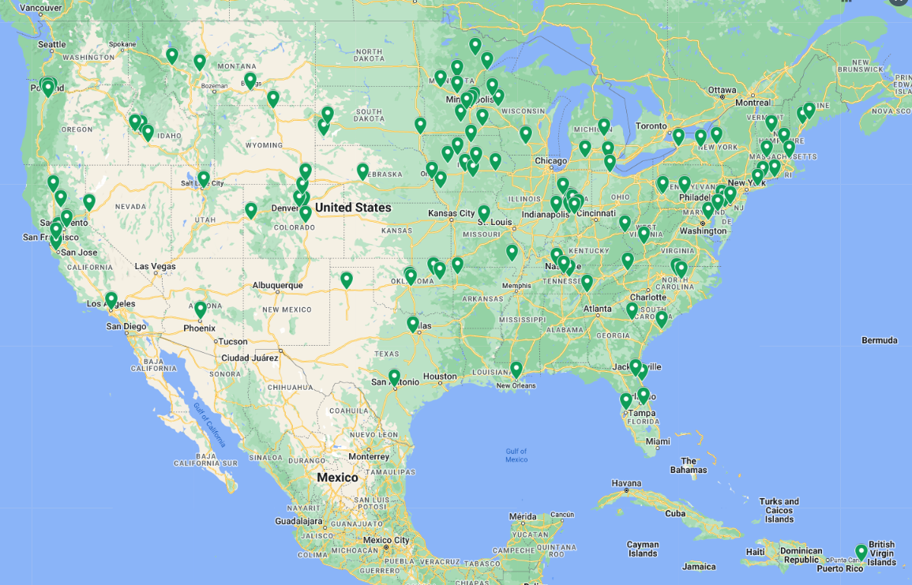
Organizational Sponsorship
Cohort 1-
Implemented site map
National Spread by VISN
VISN 1 – 2 (6) VISN 2 – 2 (5) VISN 4 – 2 (4) VISN 5 – 0 (3) VISN 6 – 2 (1) VISN 7 – 1 (1) VISN 8 – 5 (0) VISN 9 – 1 (4) VISN 10 – 9 (2) | VISN 12 – 5 (0) VISN 15 – 1 (1) VISN 16 – 1 (0) VISN 17 – 2 (1) VISN 19 – 11 (4) VISN 20 – 3 (4) VISN 21 – 1 (7) VISN 22 – 2 (0) VISN 23 – 23 (0)
Total: 73 sites successful (26 VAMCs) and 41 sites in-progress

Slide 4
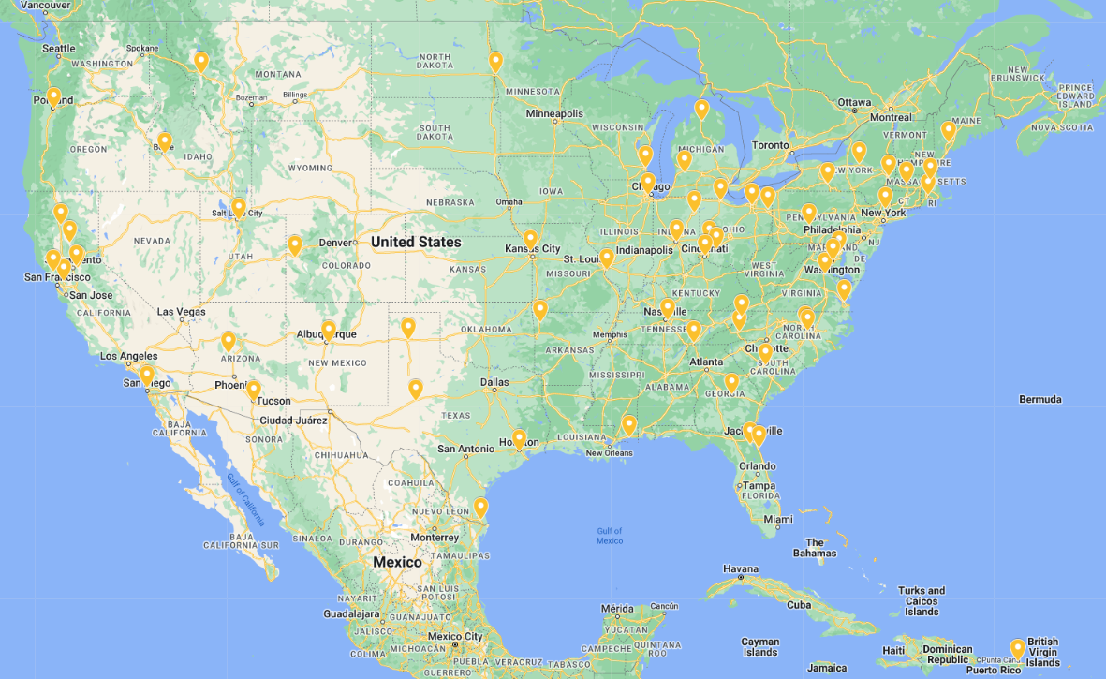
Organizational Sponsorship
Cohort 2-
Beginning Implementation
National Spread by VISN
VISN 1 (4) VISN 2 (4) VISN 4 (2) VISN 5 (1) VISN 6 (5) VISN 7 (2) VISN 8 (3) VISN 9 (3) VISN 10 (9) | VISN 12 (2) VISN 15 (2) VISN 16 (3) VISN 17 (3) VISN 19 (4) VISN 20 (2) VISN 21 (6) VISN 22 (4) VISN 23 (1)
Total: 60 sites 36 VAMCs and 24 CBOCs

Slide 5
Health Care Centers with no Current Implementation
*In FY23 73 VA sites with successful Implementation, and 47 sites in progress across 86 VAMC Health Care Systems
*End of FY23, a total of 60,952 Veterans have been seen through this initiative, representing an increase of 277% compared with all of FY22 (16,170).

Slide 6
Executive summary
When a Veteran comes in with a musculoskeletal issue, they often go through a gauntlet of testing and referrals before accessing PT. Lack of timely access to high quality PT results in poor clinical outcomes, increased healthcare utilization, and higher costs.
PACT PT offers Veterans direct access by embedding PT into the patient’s primary care team. This model has been proven to alleviate negative outcomes, improve PT care, and reduce healthcare costs. Early PACT PT findings at VHA have shown improvements in access, reductions of unnecessary referrals, and high Veteran satisfaction.
The objective of this business case is to demonstrate the value of PACT PT for Veterans, employees, and VHA.
Our analysis shows that PACT PT improves:
Veteran access by decreasing wait times and increasing rural PT availability
Veteran outcomes by getting patients into PT faster, which decreases PROMIS pain scores and often means fewer sessions are needed to reach their goals
Employee satisfaction by reducing burden on PCPs and freeing up their time to focus on co-morbidities
Cost efficiency for VHA by reducing community care referrals and unnecessary imaging or specialty consults

Slide 7
Bottom Line Upfront: Patient Aligned Care Team Physical Therapy drives improved access, employee satisfaction, and cost savings
Veterans
PACT RNs and Providers
VHA
Improved access
31% reduction in wait times¹
Increases rural access by offering same day PT treatment or PT treatment via VC
Equal or better outcomes
External research shows early PT is correlated with 89% reduced probability of taking opioids²
Early access to PT reduces chronicity³
Increased satisfaction – Vsignals as high as 97% for PACT PT (vs. 93% for PACT alone)⁴
Improves job satisfaction and retention
On a scale of 1 (strongly disagree) to 5 (strongly agree) employees report PACT PT:⁵
Improves job satisfaction (4.5)
Makes them more likely to stay in their role (4.1)
Allows them to provide patients higher quality care (4.8)
Allows non-PT providers to spend less time managing patient care for MSK or chronic pain conditions (4.0)
PACT PT drives significant cost savings:
Contributes to reducing unnecessary imaging and specialty referrals, e.g., at VISN 23 between FY17 and FY20 after PACT PT was implemented¹
77% reduction in imaging
55% reduction in pain referrals
46% reduction in ortho / surgeries
Can be implemented cost-neutrally⁶
Breakeven of ~100 community care referrals brought in-house to fund 1 additional PT⁶
Fewer sessions needed – 55% of patients required only 1 session⁷
Does not adversely impact VERA
1. Data provided by VISN 23
2. Association of Early Physical Therapy With Long-term Opioid Use Among Opioid-Naive Patients With Musculoskeletal Pain – Jama, 2018
3. Impact of interprofessional embedding of physical therapy in a primary care training clinic (2021)
4. VHA provided data
5. PT Embedded in PACT Steering Committee (2023)
6. Interviews with stakeholders at sites that implemented PACT PT & Physical Therapy Embedded in PACT (2022) document
7. Data provided by the Lake Nona VAMC

Slide 8
External research and VHA findings have demonstrated embedding PT in PACT is ultimately cost saving
External:
VHA:
$1500
Cost per patient is significantly higher when access to PT is delayed²
Referrals to community care decreased by 620 cases at the Lake Nona VAMC, leading to:
Average cost savings per patient from direct PT access for neck or back pain¹
Driven by reductions in PT sessions needed, imaging, ER visits, surgical referrals, injections etc.
Avg cost per patient ($K)
~$1.5M saved
from reduction in community care referrals for physical therapy ¹ in a single year!
$250
Days until PT received
Average cost savings per patient on direct PT costs²
0-3 days
15-28
29-90
1. https://pubmed.ncbi.nlm.nih.gov/29073842/
2. https://academic.oup.com/ptj/article/98/5/336/4925488

Slide 9
Direct access to PTs through PACT PT drives equal or better patient outcomes than the traditional PCP referral model
PT as a first line treatment is underused
Physical therapists (PTs) play a valuable role in the treatment of neuromusculoskeletal (MSK) conditions
Although PTs can be very effective primary treatment managers of MSK conditions, patients generally first go to a primary care physician (PCP)
Leveraging PT as a first line treatment can free up time for PCPS, allowing them to focus on other conditions
Earlier access to PT drives equal or better outcomes for patients
Reduces the time and number of sessions needed for recovery once therapy is started
Reduces risk of developing long-term disease or experiencing worsening symptoms
Reduces risk of reliance on pain medication
Increases compliance
MSK conditions account for 8-18% of physician office visits.¹
Back pain and arthritis are 2 of the top 10 reasons for primary care visits.²
…and can also increase employee satisfaction for PCPs, nursing staff, and PTs
Bryant Clark, Lindsay Clark, Chris Showalter & Travis Stoner (2022) A call to action: direct access to physical therapy is highly successful in the US military.
Finley CR, Chan DS, Garrison S, Korownyk C, Kolber MR, Campbell S, Eurich DT, Lindblad AJ, Vandermeer B, Allan GM. What are the most common conditions in primary care? (2018)

Slide 10
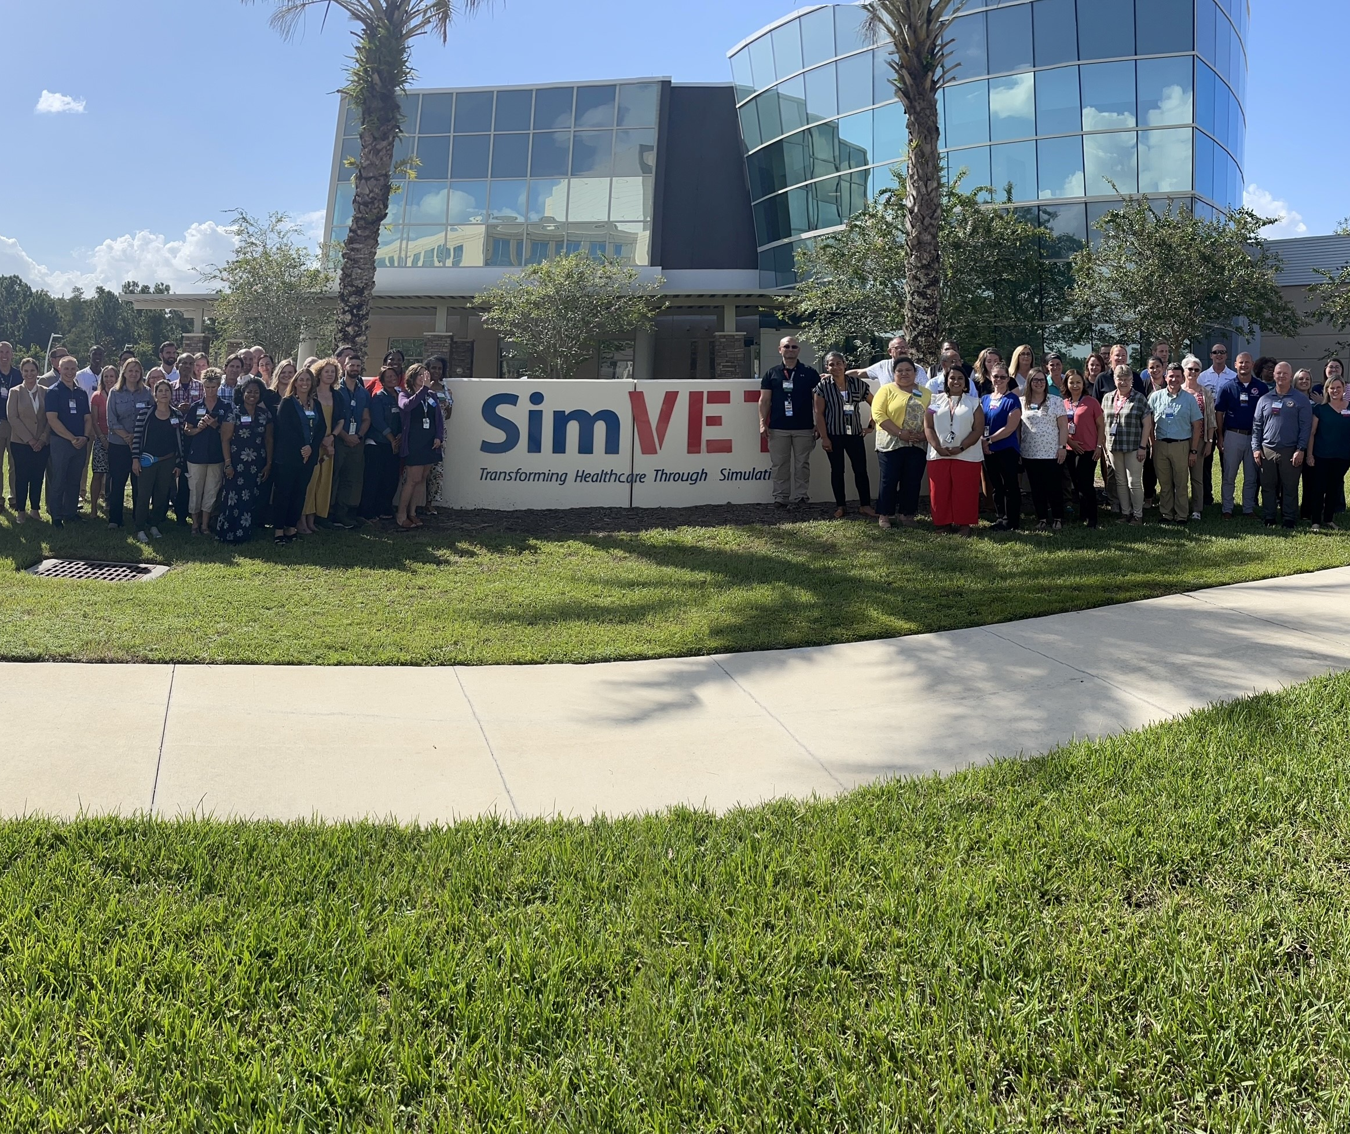
Organizational Sponsorship
Interdisciplinary Training
The Clinical Decision Making within PACT PT Workshop kicked off on August 22 & 23 at SimLEARN in Orlando, FL. The workshop had representation from 17 VISNs, and 67 participants.
Notes:
Chris
Cohort 2
What additional communication channels we should consider?
Who should we specifically target to help us recruit more facilities?
How can we best engage with underserved areas?
Training Conference at SimLEARN (August 22 – 23, 2023)
Who from the steering committee will be joining us in person?
Sustainment Planning
What approach should we use to recruit REC ICC PACT PT Coordinators?
March
Media Blitz
Publish success stories
Public Affairs
National Calls
VA PC Newsletter
C20 with Chad Kessler
April
Personalized On-Boarding
Cont social media posting
May
Final call for Cohort 2
National calls

Slide 11
Organizational Sponsorship
Interdisciplinary Training
To adequately impact all levels of implementation represented by participants, sessions included:
Simulation training
Open forum discussion
Clinical Decision Making
Implementation planning
Communication plans
PACT PT impact panel
SimLEARN SLICE network
Next steps
Resources

Slide 12
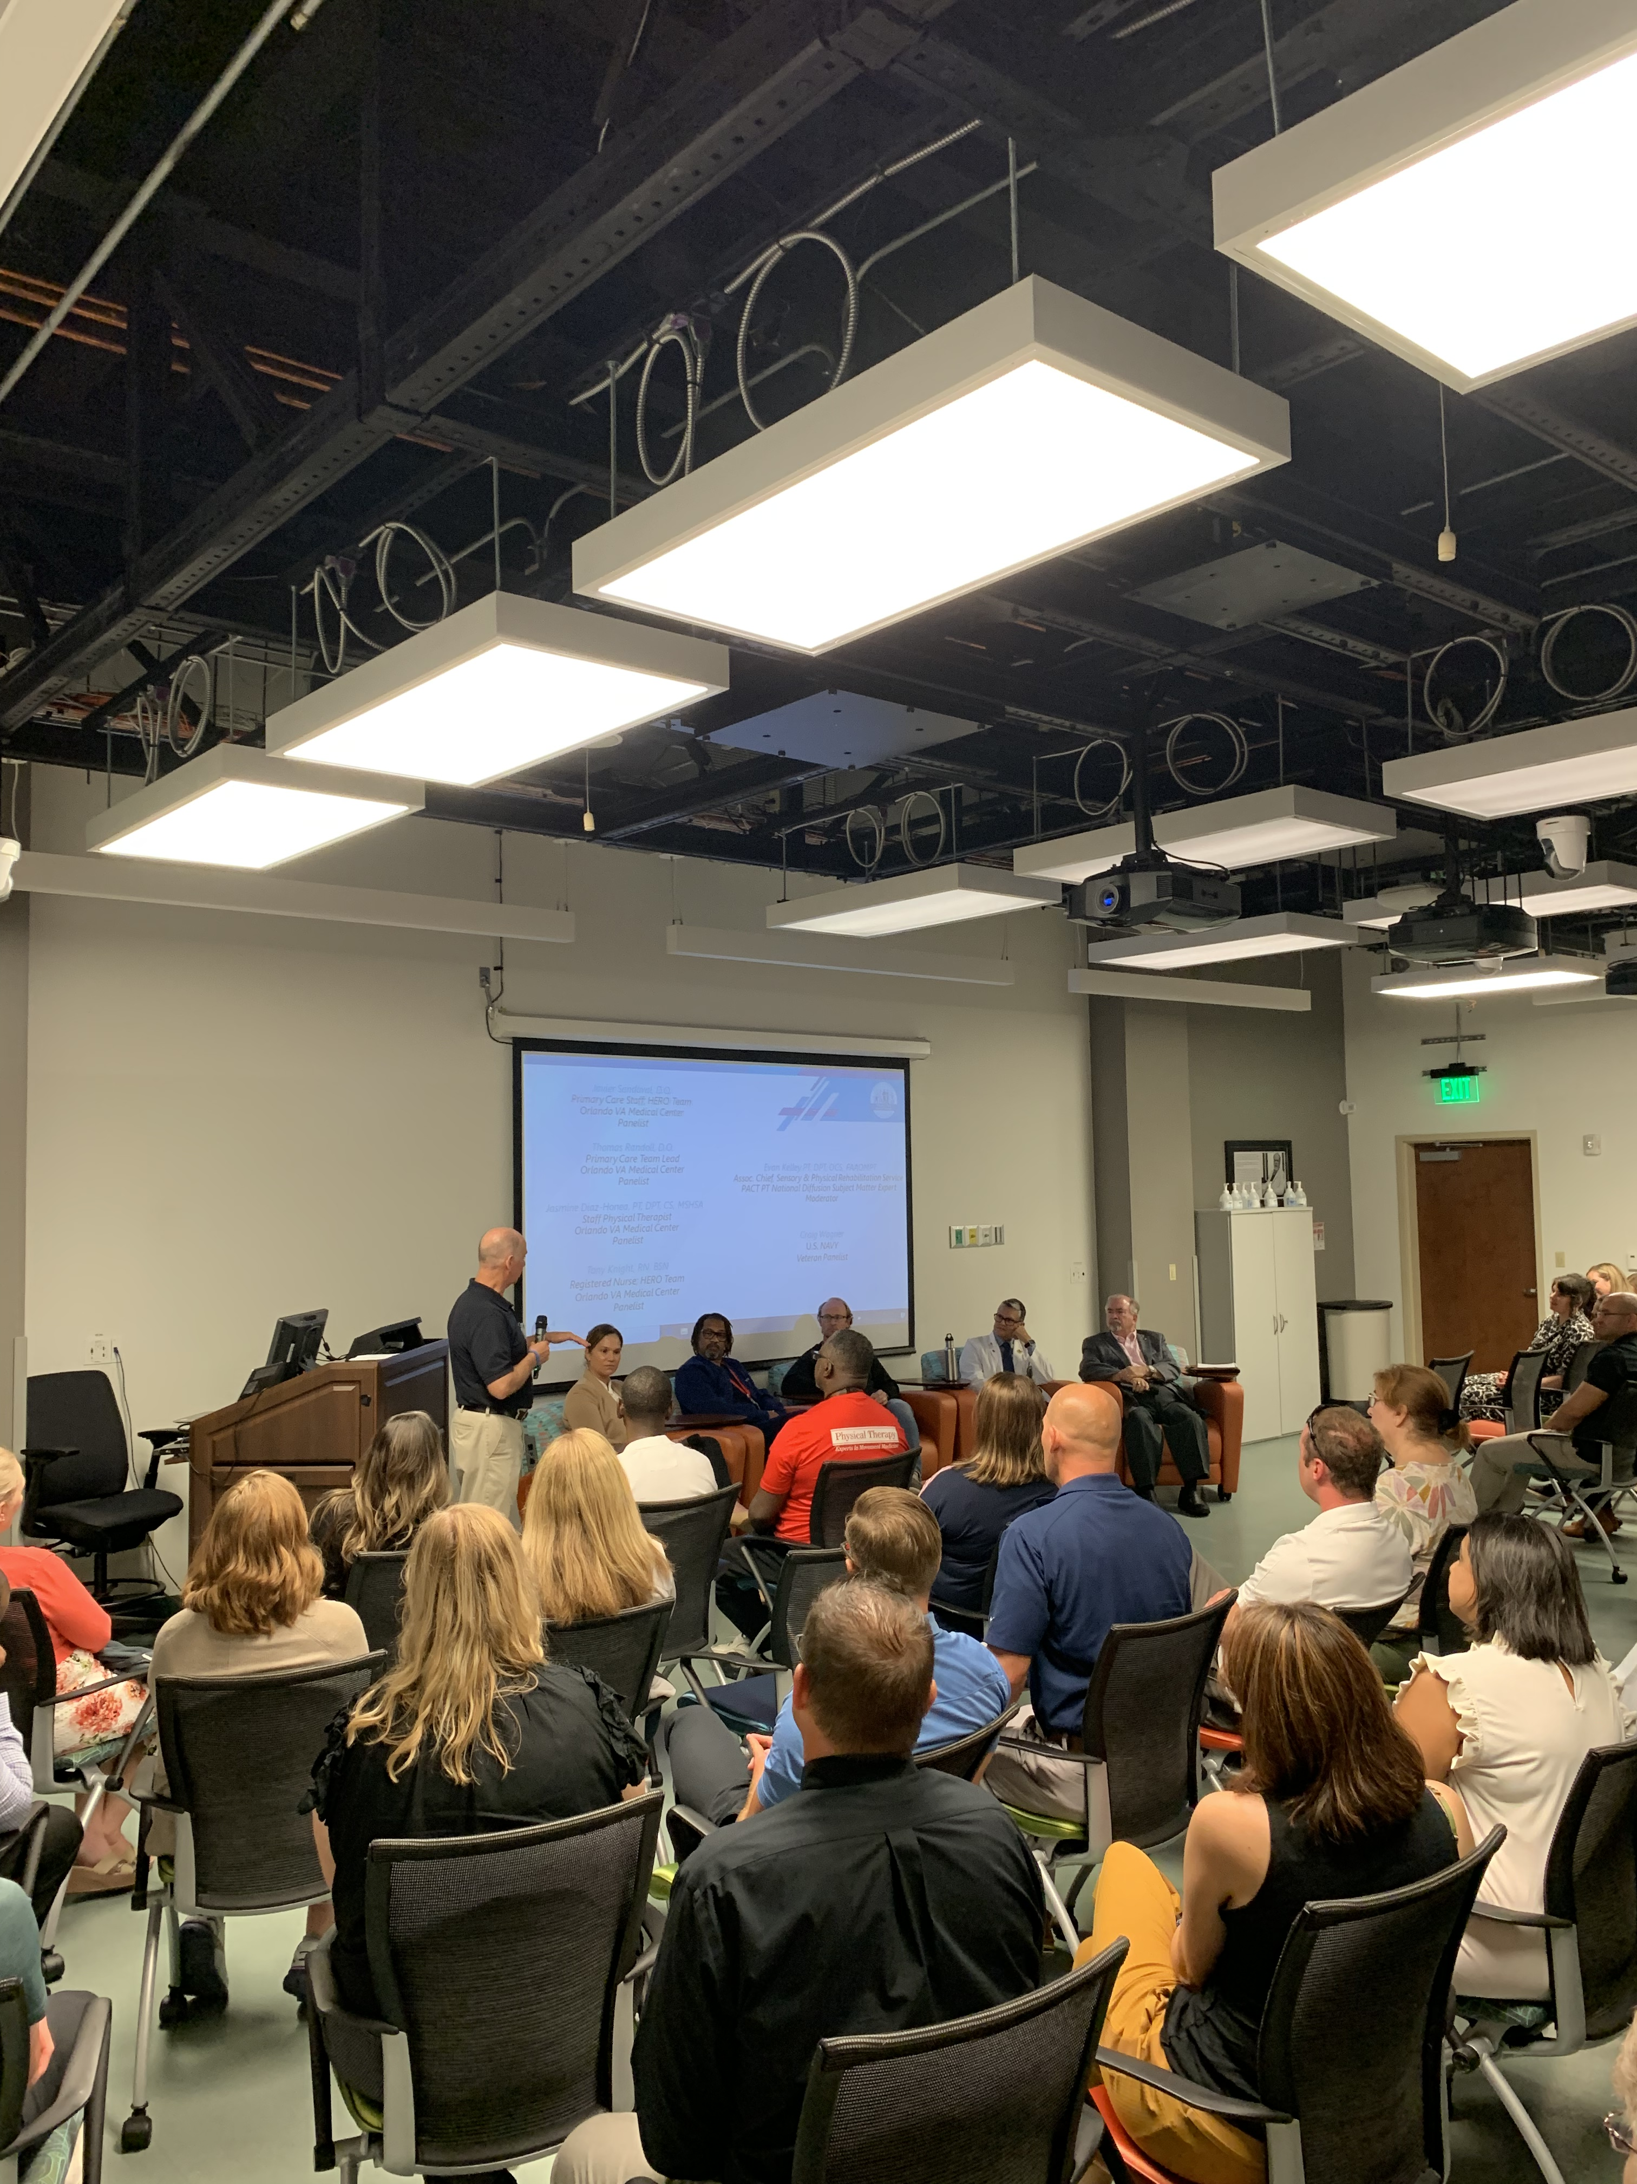
Organizational Sponsorship
Multidisciplinary Panel
Perhaps one of the most impactful moments of the workshop, a panel including providers, RNs, physical therapists, and a Veteran served by a PACT PT team relayed the impact and success of a model driven by the highest quality of care.
The power of this discussion was felt throughout the workshop and has driven next steps for multiple facilities taking home the workshop’s information.
2023 August PACT PT Workshop Video 3.mp4 (sharepoint.com)

Slide 13
Data Collection and Evaluation Methods
Dashboard
Notes:
Evan Carey

Slide 14
Dashboard Sample

Slide 15
Dashboard Sample

Slide 16
VACE Mixed-Methods Evaluation
Next Steps
Goals
Describe program implementation across sites,
Provide feedback to implementing teams to facilitate implementation,
Describe the reach of PT in PACT at implementing sites (site and national level),
Describe PT in PACT effectiveness and impact, and
Describe PT in PACT program sustainability.
Scope
Evaluation will sample PT in PACT sites:
FY 17 V23 strategic initiative (quantitative/qualitative)
FY21 Initial Diffusion sites (quantitative/qualitative)
FY22/23 Cohort 1 (quantitative/qualitative)
Cohort 2 (qualitative – narrow scope: adoption and Veteran experience)
Timeline
Evaluation activities are in progress (FY23-FY24)
Report preliminary findings (early FY24)
Collaborative feedback/inquiry from partners will iteratively inform FY24 data collection and analyses
Disseminate FY24 final report and products (date TBD in collaboration with partners)

Slide 17
V-Signals Results FY23
Very high Veteran satisfaction, specifically in quality and equity

Slide 18
E-Signals
100% of respondents would recommend the PACT PT Program to other VAMCs

Slide 19
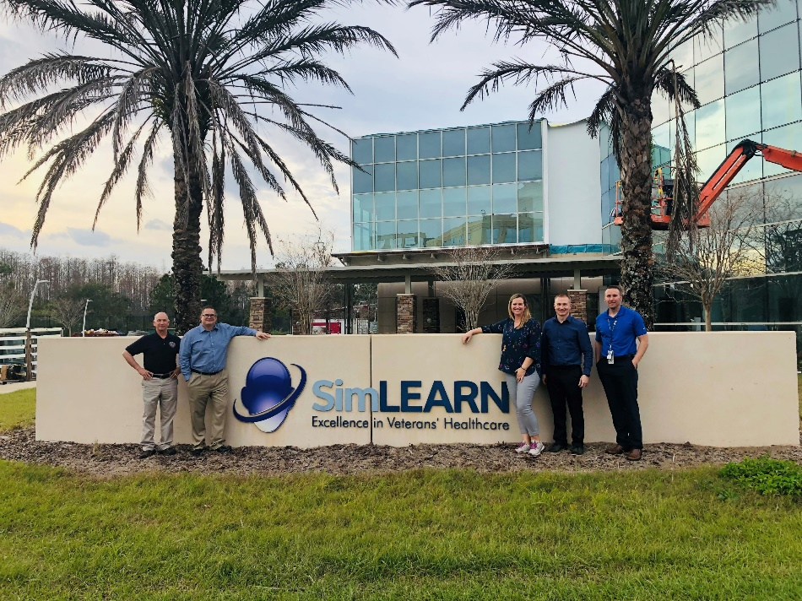
Resourcing
Updates
Join the PACT PT Community of Practice
Additional content posted to VA-APTA MOU
Presentation at August Primary Care PACT To the Future with plans for same in November
Diffusion Team presenting on VISN calls – Next is VISN 1 October 16, 2023
Presentation at PT National Conference Boston, MA in February 2024
United States PT Value Report www.ValueofPT.com*
Planning for another SimLearn F2F Workshop in April 2024 with an emphasis on cohort 3 sites
Notes:
Ashley
VA-APTA MOU Courses: 5 courses posted; 5 in final recording phase
E-Signals: 2/14-2/28; Audience: PACT PCP, PT, mid-levels, RNs, LPNs, MSAs, ancillary team members (MH) – we will get into some results here shortly….
CSM – networking, marketing and recruiting for Cohort 2 sites, discussions on what is happening in VA and planning content to present at CSM 2024
Advanced PACT PT course: We met with a lot of people from VHA/DOD, discussions regarding a need for advanced training & exploring an opportunity to collaborate with Dept of Defense and VA to develop advanced PACT PT course. Early discussions, trying to figure out the best way to do this.

Slide 20
Implement PACT PT across all VHA sites – focusing first on sites with high rates of community care referrals for PT- Part of VHA Long Term Goals with collaboration of PC and RPS
Implement a robust data collection plan to centrally gather outcome and benefit data
Collaborate with DoD/DHA and the private sector to market this work to transform healthcare
Continue to be thoughtful about empowering PTs within PACT teams, and ensuring high quality “fit”
Recommendations

Slide 21
Questions?
For questions or feedback, please email vhacihpactptdiffusionteam@va.gov.
Office Hours 1st and 3rd Tuesday @11am EST Diffusion Marketplace (va.gov)
PACT PT Business Case.pdf
PT Marketplace Physical Therapy Marketplace and share among your colleagues- Home (sharepoint.com)

