Slide 1
Cognitive Screening In Primary Care
For Providers
Presented by:
Jocelyn Havana Almazan
RN-BSN, CMSRN
DIFFUSION FELLOW

Slide 2
Introduction
The cognitive screening for use in Primary Care idea was developed from the discussion of three registered nurses. Patients with apparent cognitive decline were noted to have no interventions. Current literature identifies that the Mini-Cog is a valid, reliable and accessible tool for cognitive impairment screening.
In the past, CPRS did not have any cognitive impairment screening tools.
Our team collaborated with Social Worker and Neuropsychologist who supported the project.
Notes:
Bullet #1 should state, “The cognitive screening idea for Primary Care was developed….” then, Patients with apparent cognitive decline were noted to have…..” then, “Current literature identifies the Mini-Cog as a valid, reliable, and accessible tool for cognitive impairment screening”
Bullet #2 should state, “CPRS did not”
Bullet #3 “Our team collaborated with a Social Worker and Neuropsychologist who supported the project”

Slide 3
Early Diagnosis is Important
Early diagnosis can prevent the overuse of expensive medical resources.
The patient can better participate in health care, legal, and financial planning while decision-making capacity is still intact, and the decision still reflects his or her wishes.
Early diagnosis helps to separate dementia from healthy aging or age-related cognitive decline.
According to the Alzheimer’s Association organization only 16% of seniors report receiving regular cognitive assessments
(Alzheimer’s Association, 2019)

Slide 4
Cognitive Assessment and Plan Services
As of January 1, 2022, Medicare pays approximately $283 (may be geographically adjusted) for these services when provided in an office setting (CMS.gov , 2022)
Detecting cognitive impairment is a required element of Medicare’s Annual Wellness Visit (AWV). You can also detect cognitive impairment as part of a routine visit through direct observation or by considering information from the patient, family, friends, caregivers, and others. You may also use a brief cognitive test and evaluate health disparities, chronic conditions, and other factors that contribute to increased risk of cognitive impairment.

Slide 5
What is Mini-Cog
The Mini-Cog© is a 3-minute instrument that can increase the detection of cognitive impairment in older adults. It can be used effectively after a brief training in both healthcare and community settings. (Mini-Cog, n.d.)
The Mini-Cog has sensitivity and specificity in some studies as high as 91% and 86% (Brickley, 2017).
Mini-cog consists of two components, a 3-item recall test for memory and a scored clock drawing test.
The goal of screening for cognitive impairment in primary care is to find patients with cognitive deficits have gone unnoticed or unrecorded in routine clinical encounters. Symptoms may be severe enough to interfere with the patient’s self-care and medical management. (Mini-Cog, n.d.).
Notes:
Bullet #3 Instead of “it” use “The Mini-cog consists of ……”
Bullet #4 “the goal of screening for cognitive impairment in primary care is to find patients with cognitive deficits that have gone unnoticed…..”

Slide 6
The Role of the PACT Team
LPN: Our Eyes and Ears RN: Care Coordinator
Diagnosing can be difficult due to patients often have subtle symptoms early in the disease course.
Memory loss, behavioral, and mood changes reported by a spouse, relative, or close friend is more predictive of dementia.
Memory loss reported by the patient is more predictive of depression.
Perform Mini-Cog, document and add PCMHI if veteran failed test.
Assessment, utilization, care coordination, perform and document Mini-Cog and add PCMHI if veteran failed the test.
Notes:
Removed the first word under LPN “ Because”, “Diagnosing can be difficult due to patients often having subtle symptoms…..”
Under RN, what does “perform” mean? Are you saying “Perform and document the Mini-cog”?

Slide 8
The Role of the PACT Team
Doctors and Nurse Practitioners :
Primary Care Mental Health
Integration (PCMHI):
Assessment and utilization of full cognitive assessment
Saint Louis University Mental Status (SLUMS)
Montreal Cognitive Assessment (MoCA)
Documentation and recommendations
PCP will consult neuropsychologist for comprehensive assessment, interpretation, and recommendations once Mini-Cog and SLUMS or MoCA completed

Slide 9
The Plan
If Veteran fails Mini-Cog, administered by the RN/LPN/HT , they will notify PCMHI that patient failed mini-cog
PCMHI will administer SLUMS or MoCA and make recommendations to PCP
PCP will consult or e-consult Neuropsychologist
Neuropsychologist will assess, evaluate, and recommend regarding care needed
Notes:
Veteran is always capitalized in the VA
Bullet #1 “nursing will notify PCMHI of the results”

Slide 10
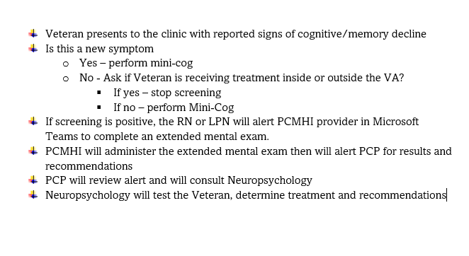
Cognitive Screening Process in Primary Care
Notes:
This is blurry, needs to be replaced with clearer copy

Slide 11
Screening Tools
Deficits in two (2) or more areas of cognition warrant further testing
Orientation and Registration
Visuospatial and executive functioning
Language
Attention and working memory
Memory
PCMHI
Saint Louis University Mental Status (SLUMS)
Montreal Cognitive Assessment (MoCA)
Health Care Professional
Mini-Cog
Neuropsychologist
Neuropsychological Testing: useful in the detection, diagnosis, and management of dementia syndromes (Rascovsky, 2016).

Slide 12
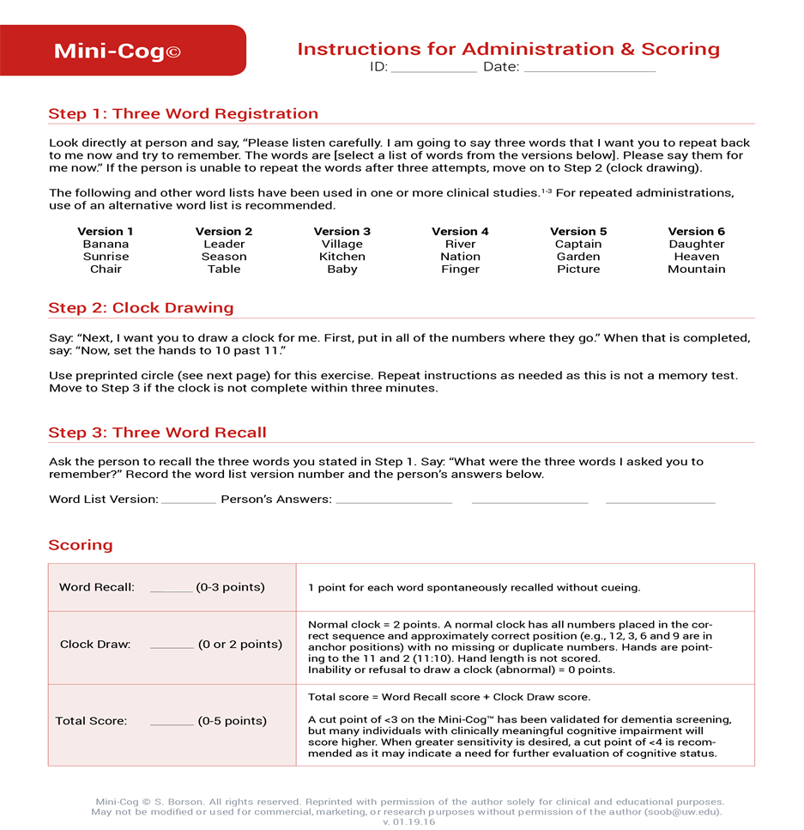
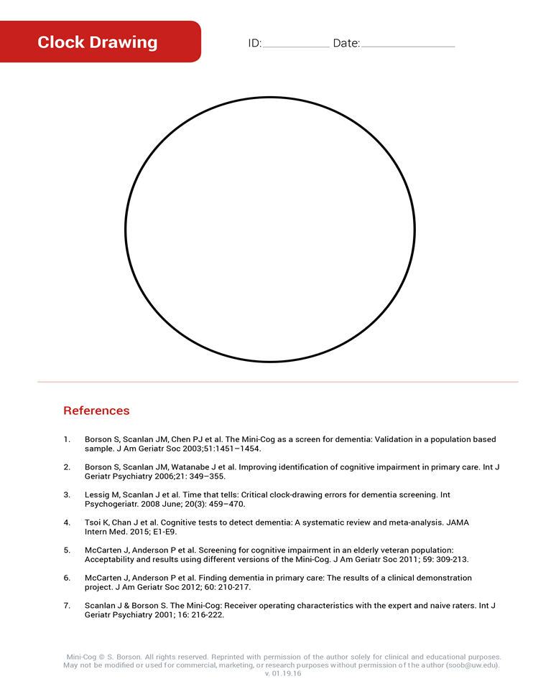
Mini-Cog form

Slide 13
Mini-Cog Charting

Slide 14
Mini-Cog Data at The VA Clinic and NF/SG

Slide 15
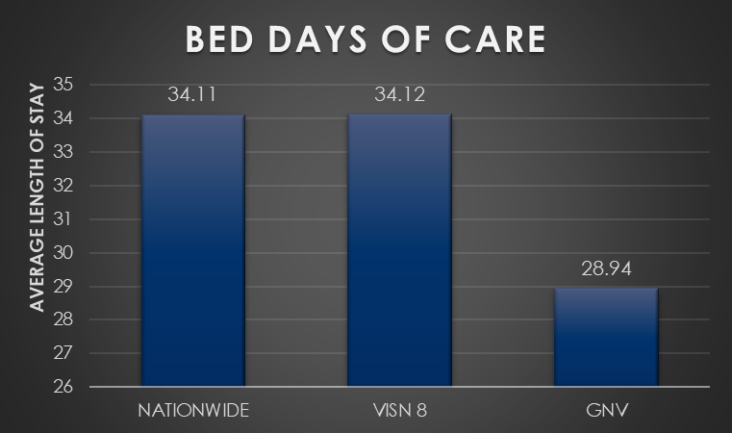
Dementia Diagnosis and BDOC

Slide 16
Programs that will benefit the Veteran and Family
Program of Comprehensive Assistance for Family Caregivers (PCAFC)
Caregiver support program (csp)
The CSP promotes the health and well-being of family caregivers who care for our nation's Veterans.
FOUR CORE ELEMENTS:
Education and Support
Collaboration and Partnerships
Outreach
Resources and Referrals
PCAFC services for eligible Family Caregivers include:
Education and Training
Access to Healthcare Insurance (If caregiver is otherwise uninsured)
Mental Health Counseling
Financial Stipend
Enhanced Respite
Travel and per diem compensation (when traveling for a Veteran's VA medical appointment)
Financial Planning and Legal Services (New under Expansion)

Slide 17
Who can do this Mini-Cog?
You can!
This screening takes less than five minutes
You can perform this simple test to better serve our Veterans

Slide 18
References
Alzheimer’s Association. (2019). Alzheimer’s disease facts and figures. Retrieved from https://www.alz.org/media/Documents/alzheimers-facts-and-figures-infographic-2019.pdf
Brickley, L. (2017). Bates’ guide to physical examination and history taking (12th ed). Philadephia: Wolters Kluwer.
Brosch, M.D., MSc, J.R, & M.R. (2018). Early-onset dementia in adults. UpToDate. Retrieved May 16, 2019, from https://www.uptodate.com/contents/early-onset-dementia-in- adults?search=definitionofdementia&source=search_results&selectedTitle=3~150&usage_type=default&display_rank=3.
Centers for Disease Control and Prevention (2019). Healthy People 2020. Retrieved from: Instrumenthttps://mini-cog.com/mini-cog-instrument/standardized-mini-cog-instrument/
Chambers, T., & McDougall, M. (2019). Dementia Teletriage: A Review of an Organization's Internal Process and Impact. ViewPoint, 41(3), 3–7.
Graff-Radford, M.D.J. (2018). Alzheimer’s and dementia: What’s the difference? Retrieved from https://www.mayoclinic.org/disease-conditions/alheimers-disease/expert- answers/alzheimers-and-dementia-whats-the-difference/faq-20396861.
Gupta, R., Chari, D., & Ali, R. (2015). Reversible dementia in elderly: Really uncommon? Journal of Geriatric Mental Health, 2(1), 30–37. doi: 10.4103/2348-9995.161378
Keene, MD,PhD., C.D., Montine MD,PhD., T.J., & Kuller MD. PhD., L.H. (2018). Epidemiology, pathogenesis of Alzheimer disease. Retrieved May 16, 2019, from https://www.uptodate.com/contents/epidemiology-pathology-and-pathogenesis-of -Alzheimer-disease?search=definition of dementia&source=search_results&selectedTitle=2~150&usage_type=default&display_rank=2#H617807593.
Rascovsky,K.(2016). A Primer in Neuropsychological Assessment for Dementia. Retrieved from https://pdfs.semanticscholar.org/2735/d926e84bd094452562127fb594c0e7500d3e.pdf?_ga=2.75911957.1698375006.1581104324-1723242729.1581104324
Teng, MD, PhD, E. (2018). The mental status examination in adults. Retrieved from https://www.uptodate.com/contents/themental-status-examination-in- adults?search=dementiascreeing&source=search_results&selectedTitle=2~41&usage_type=default&display_rank=2#H28388670AAACN.

Slide 19
Thank You
FR
FABRIKAM RESIDENCES

